Slide 1
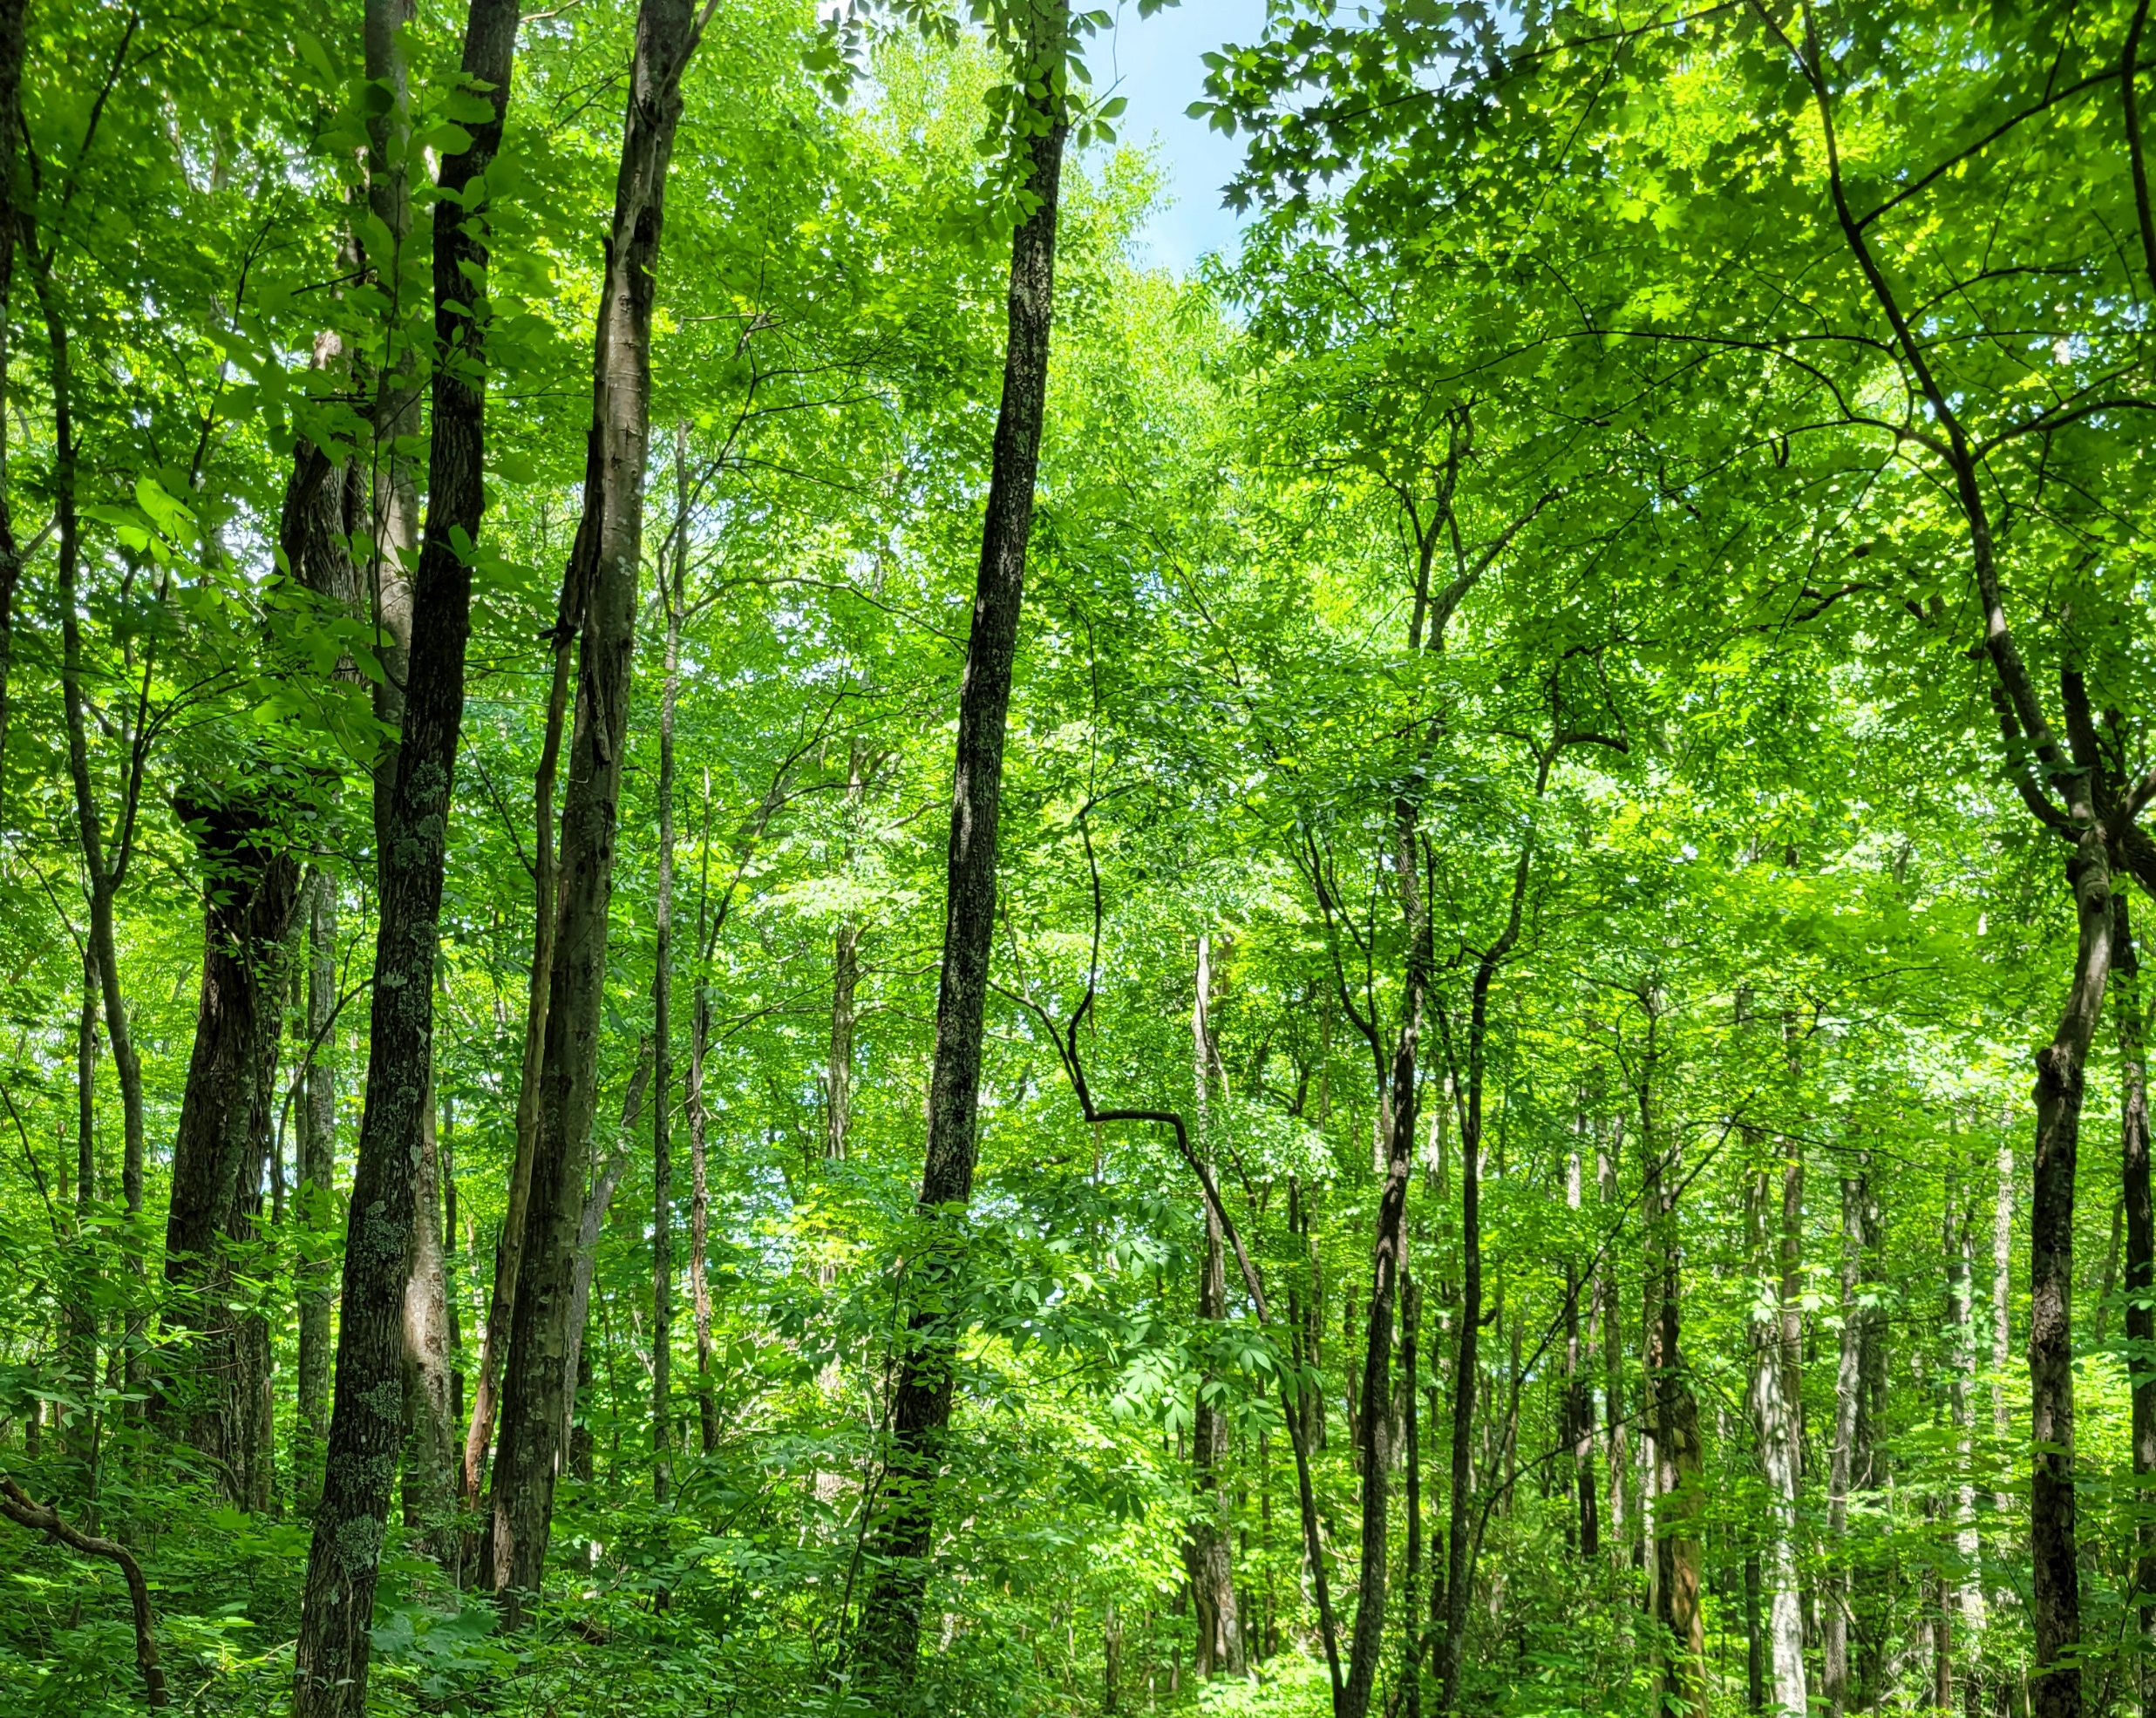
Regulation of nonstructural carbohydrate dynamics
Biological Insights from a Mathematical Analysis
Scott W Oswald, Doug P. Aubrey, Dan M. Ricciuto, Jeff M. Warren
Ecological Society of America, Montréal, QC
August 18, 2022

Slide 2
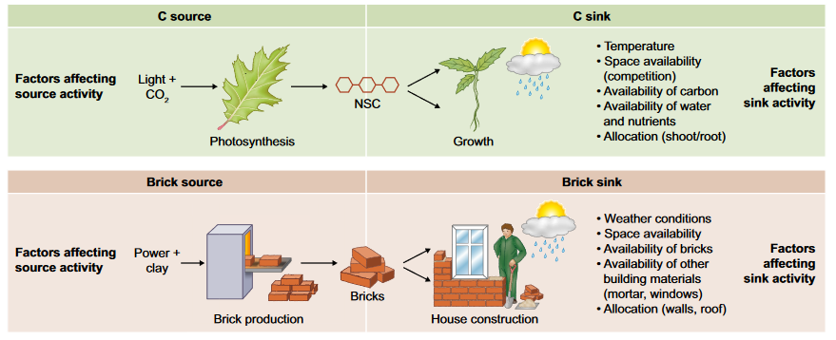
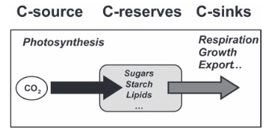
Fig 1. Fatichi et al. 2019
Nonstructural Carbohydrates = NSC
Sala et al. 2011; Sala et al. 2012

Slide 3
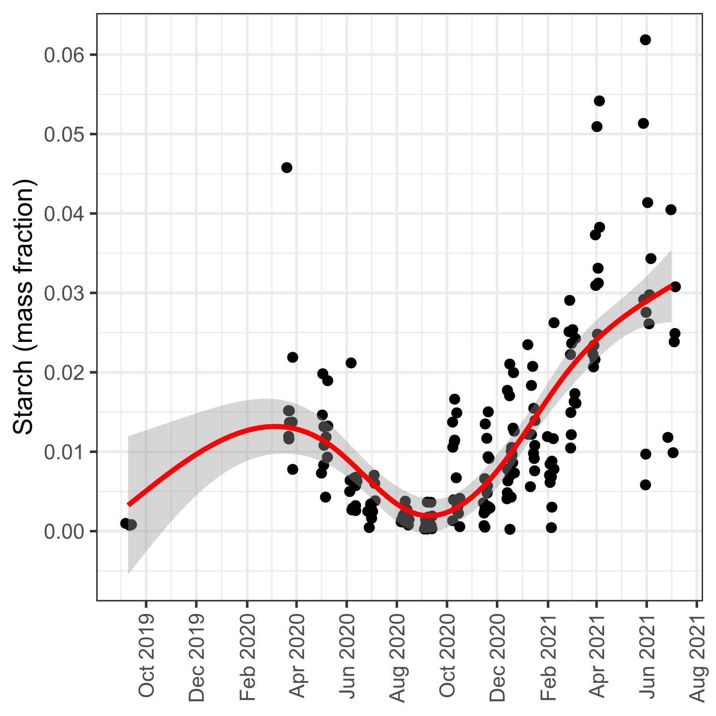
From here to there…

Slide 4
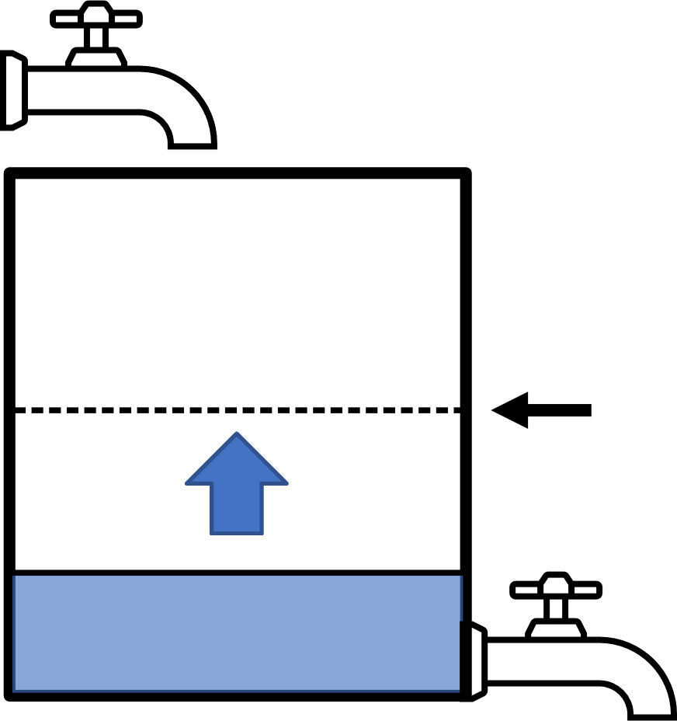
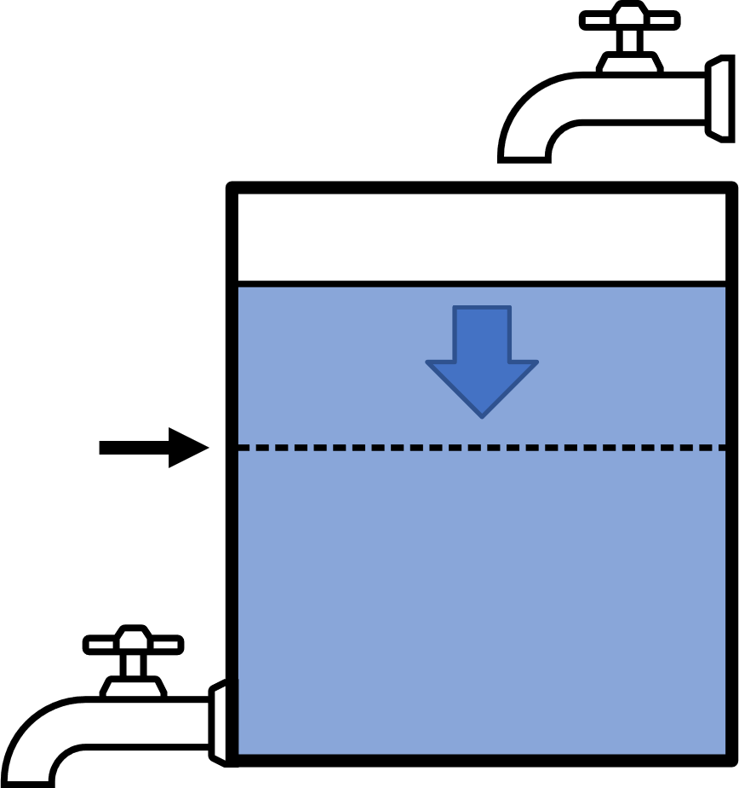
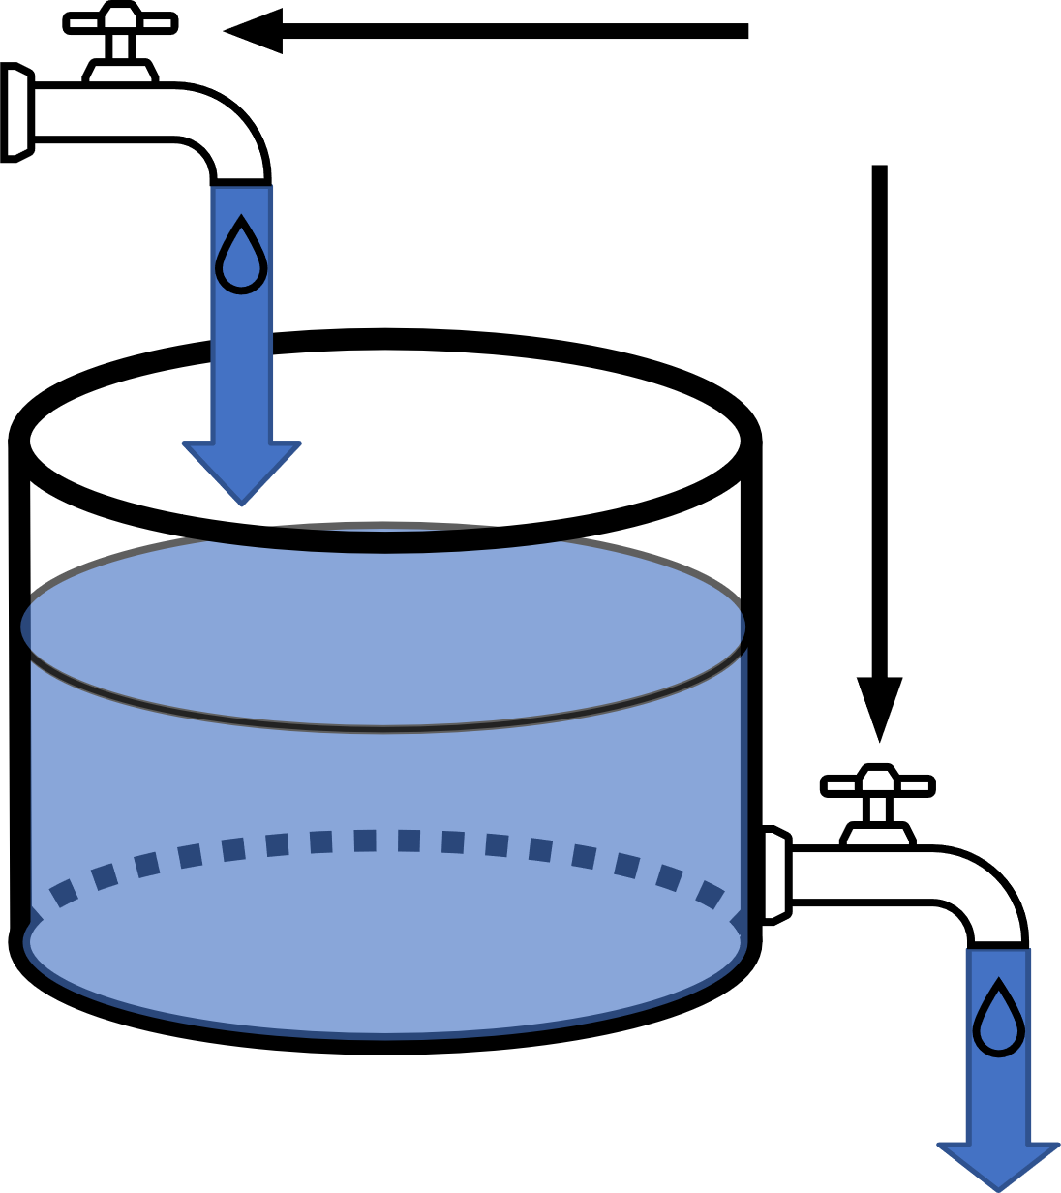
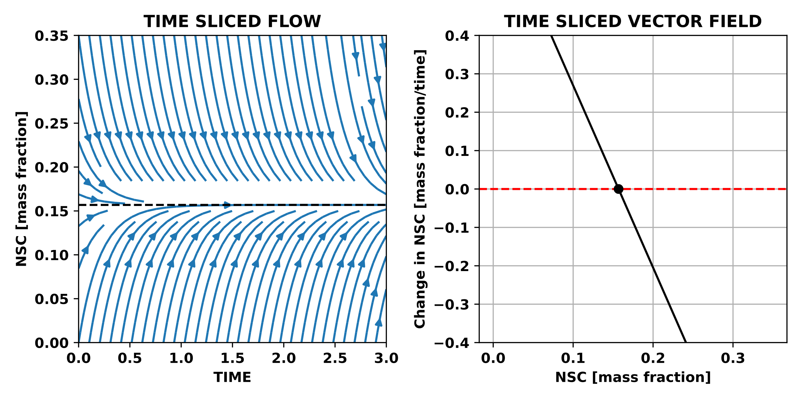
Photosynthesis
Adjustable
Balance point
NSC
Respiration + Growth
Balance point

Slide 5
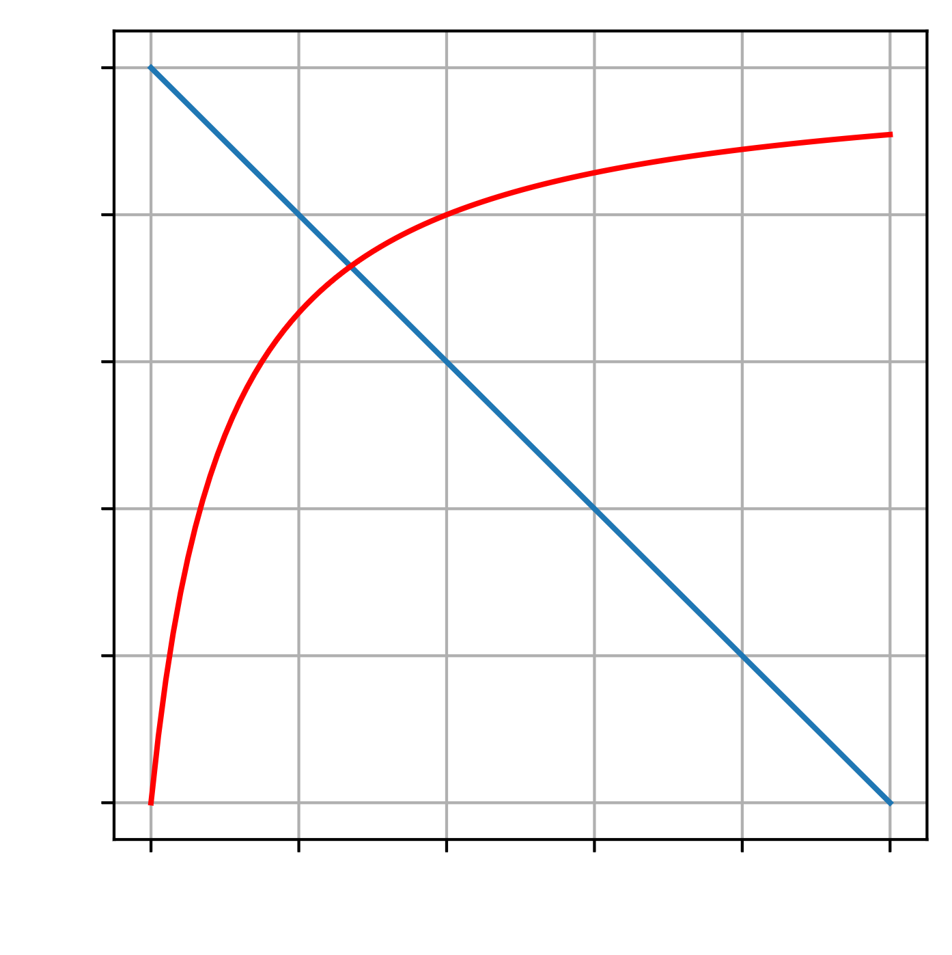
Photosynthesis = Supply
Demand Rate
Adjustable
Rate
Supply Rate
Respiration + Growth = Demand
NSC

Slide 6
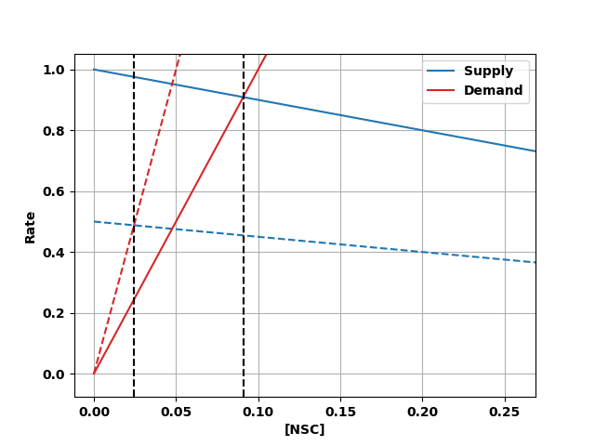
Photosynthesis = Supply
Adjustable
Respiration + Growth = Demand

Slide 7
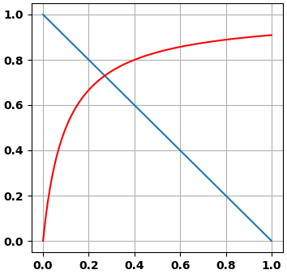
Photosynthesis = Supply
Adjustable
Rate
NSC
Respiration + Growth = Demand

Slide 8
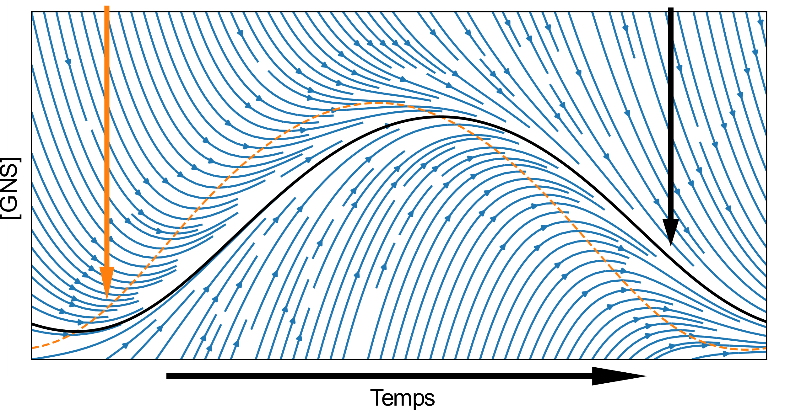
Balance point
Attractor
[NSC]
Time

Slide 9
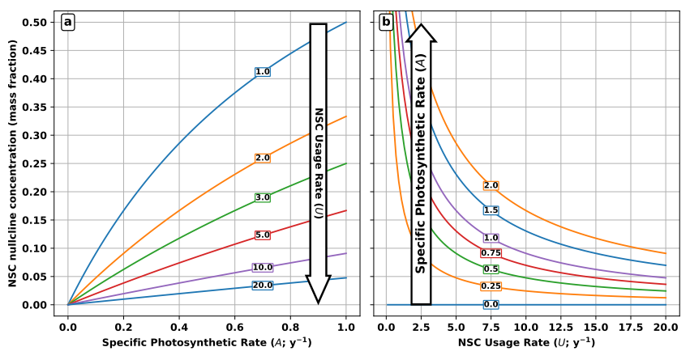
NSC balance point (mass fraction)

Slide 10
NSC balance point (mass fraction)

Slide 12
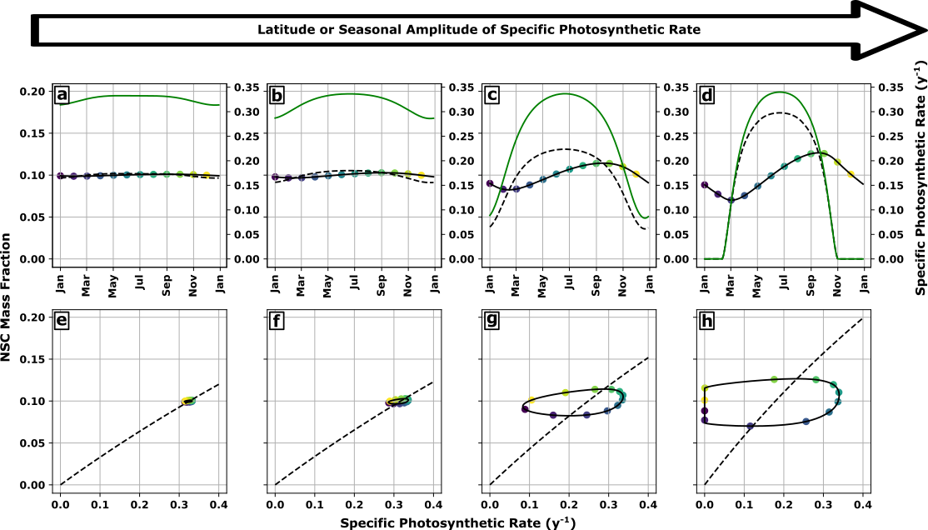

Slide 14
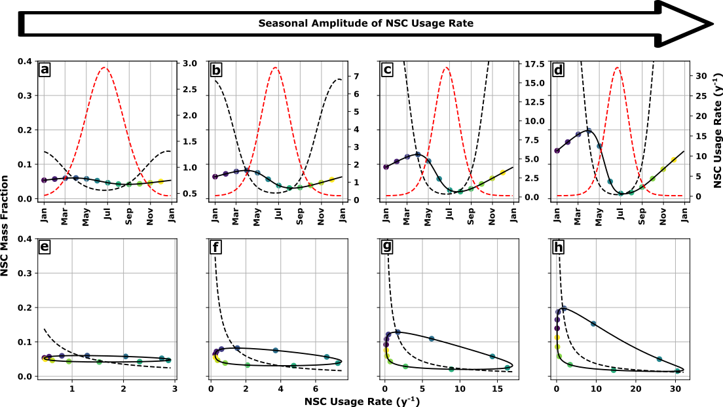

Slide 16
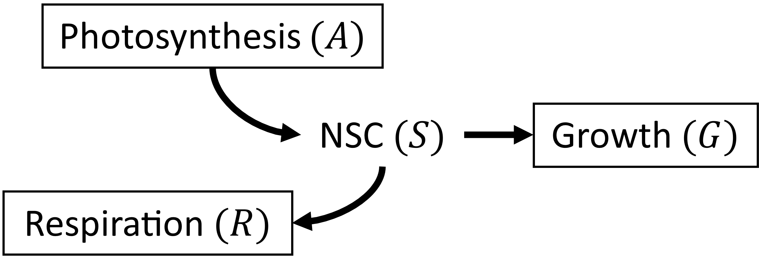
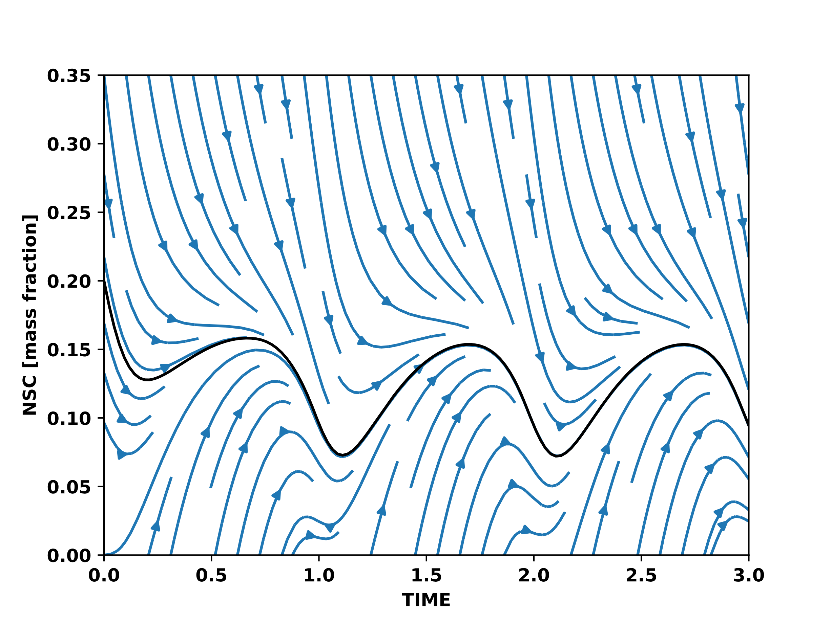
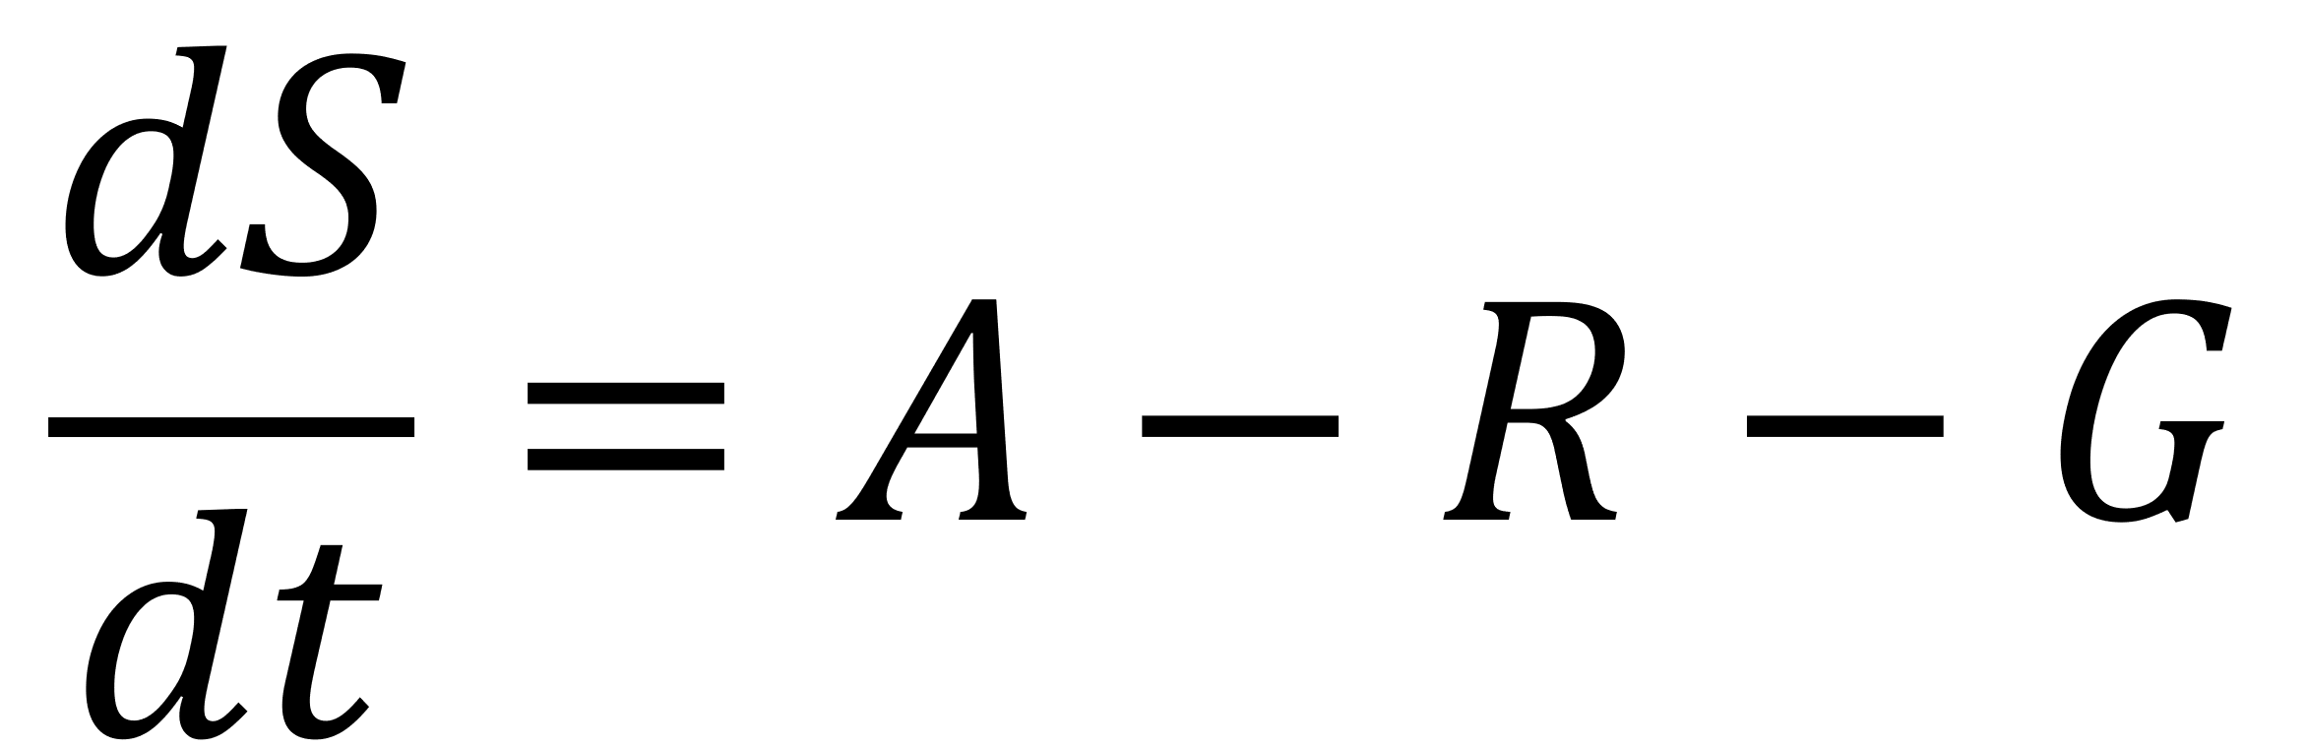
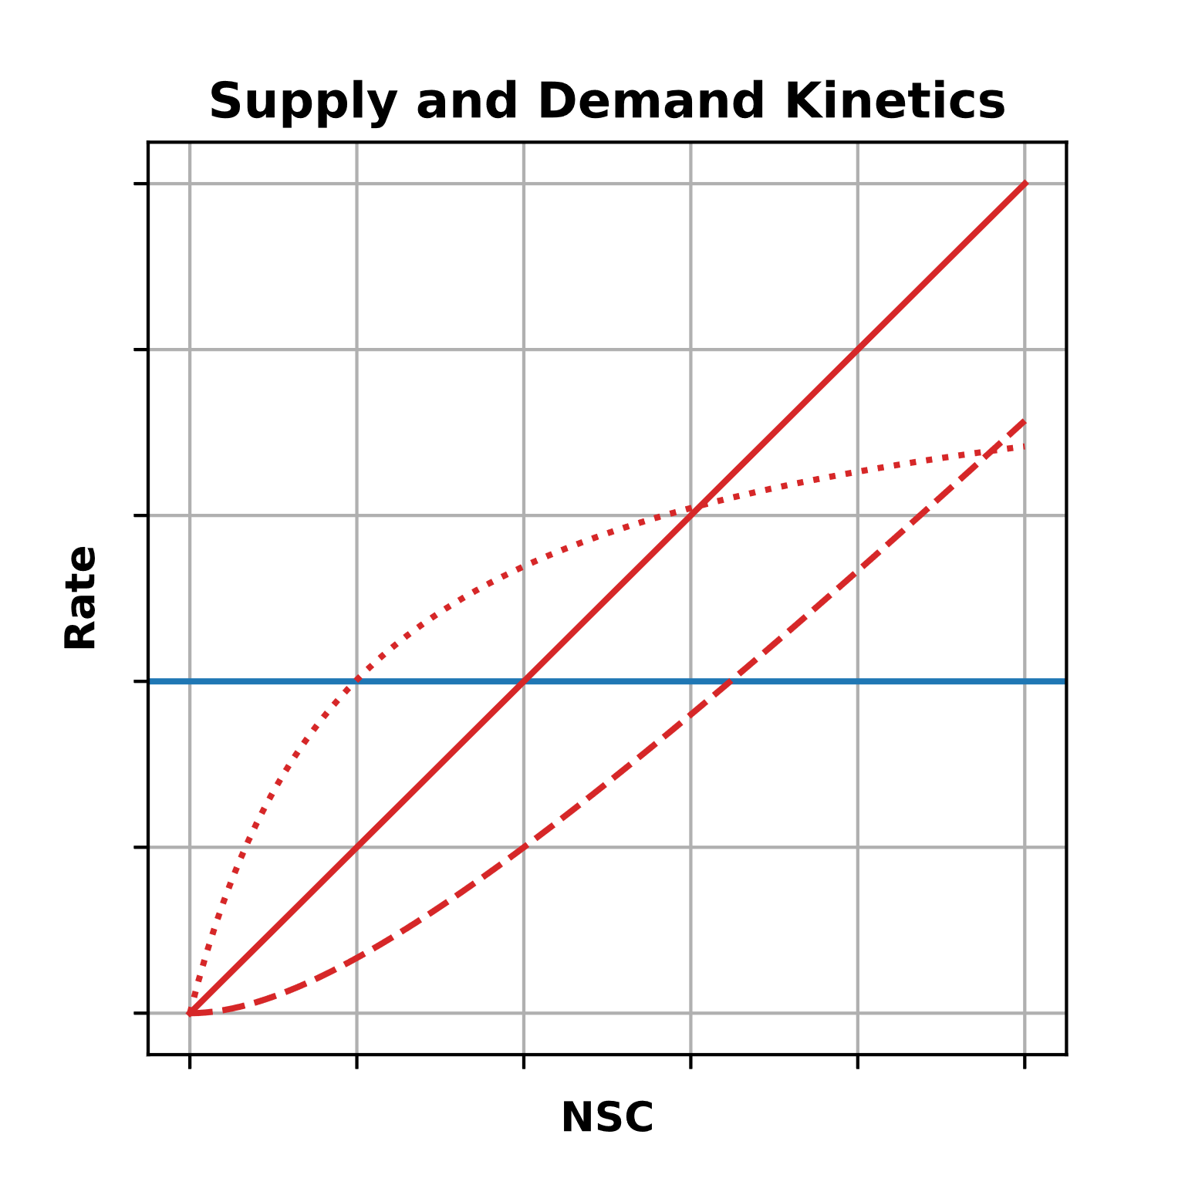

Slide 17
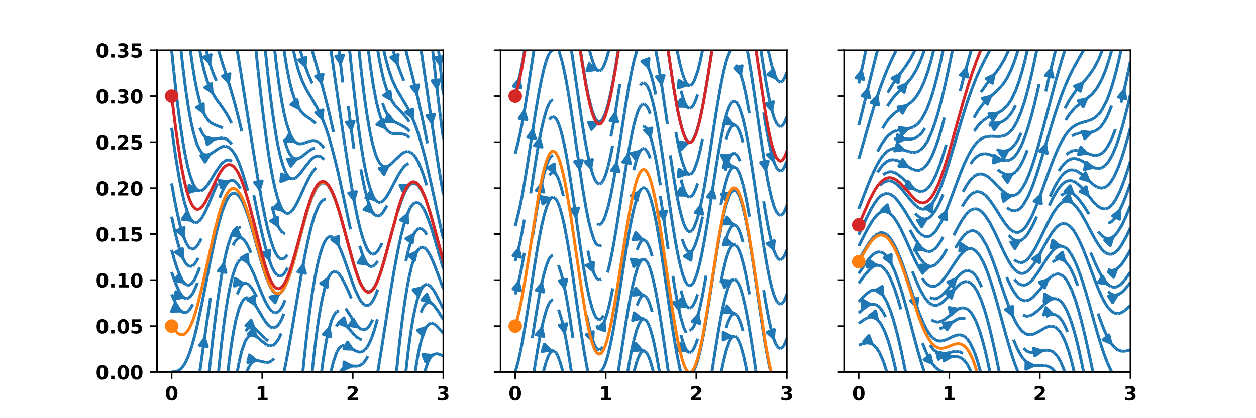
NSC (mass fraction)
Time (y)

Slide 18
NSC (mass fraction)
Time (y)
Time (y)

Slide 19
NSC (mass fraction)
Time (y)

Slide 20
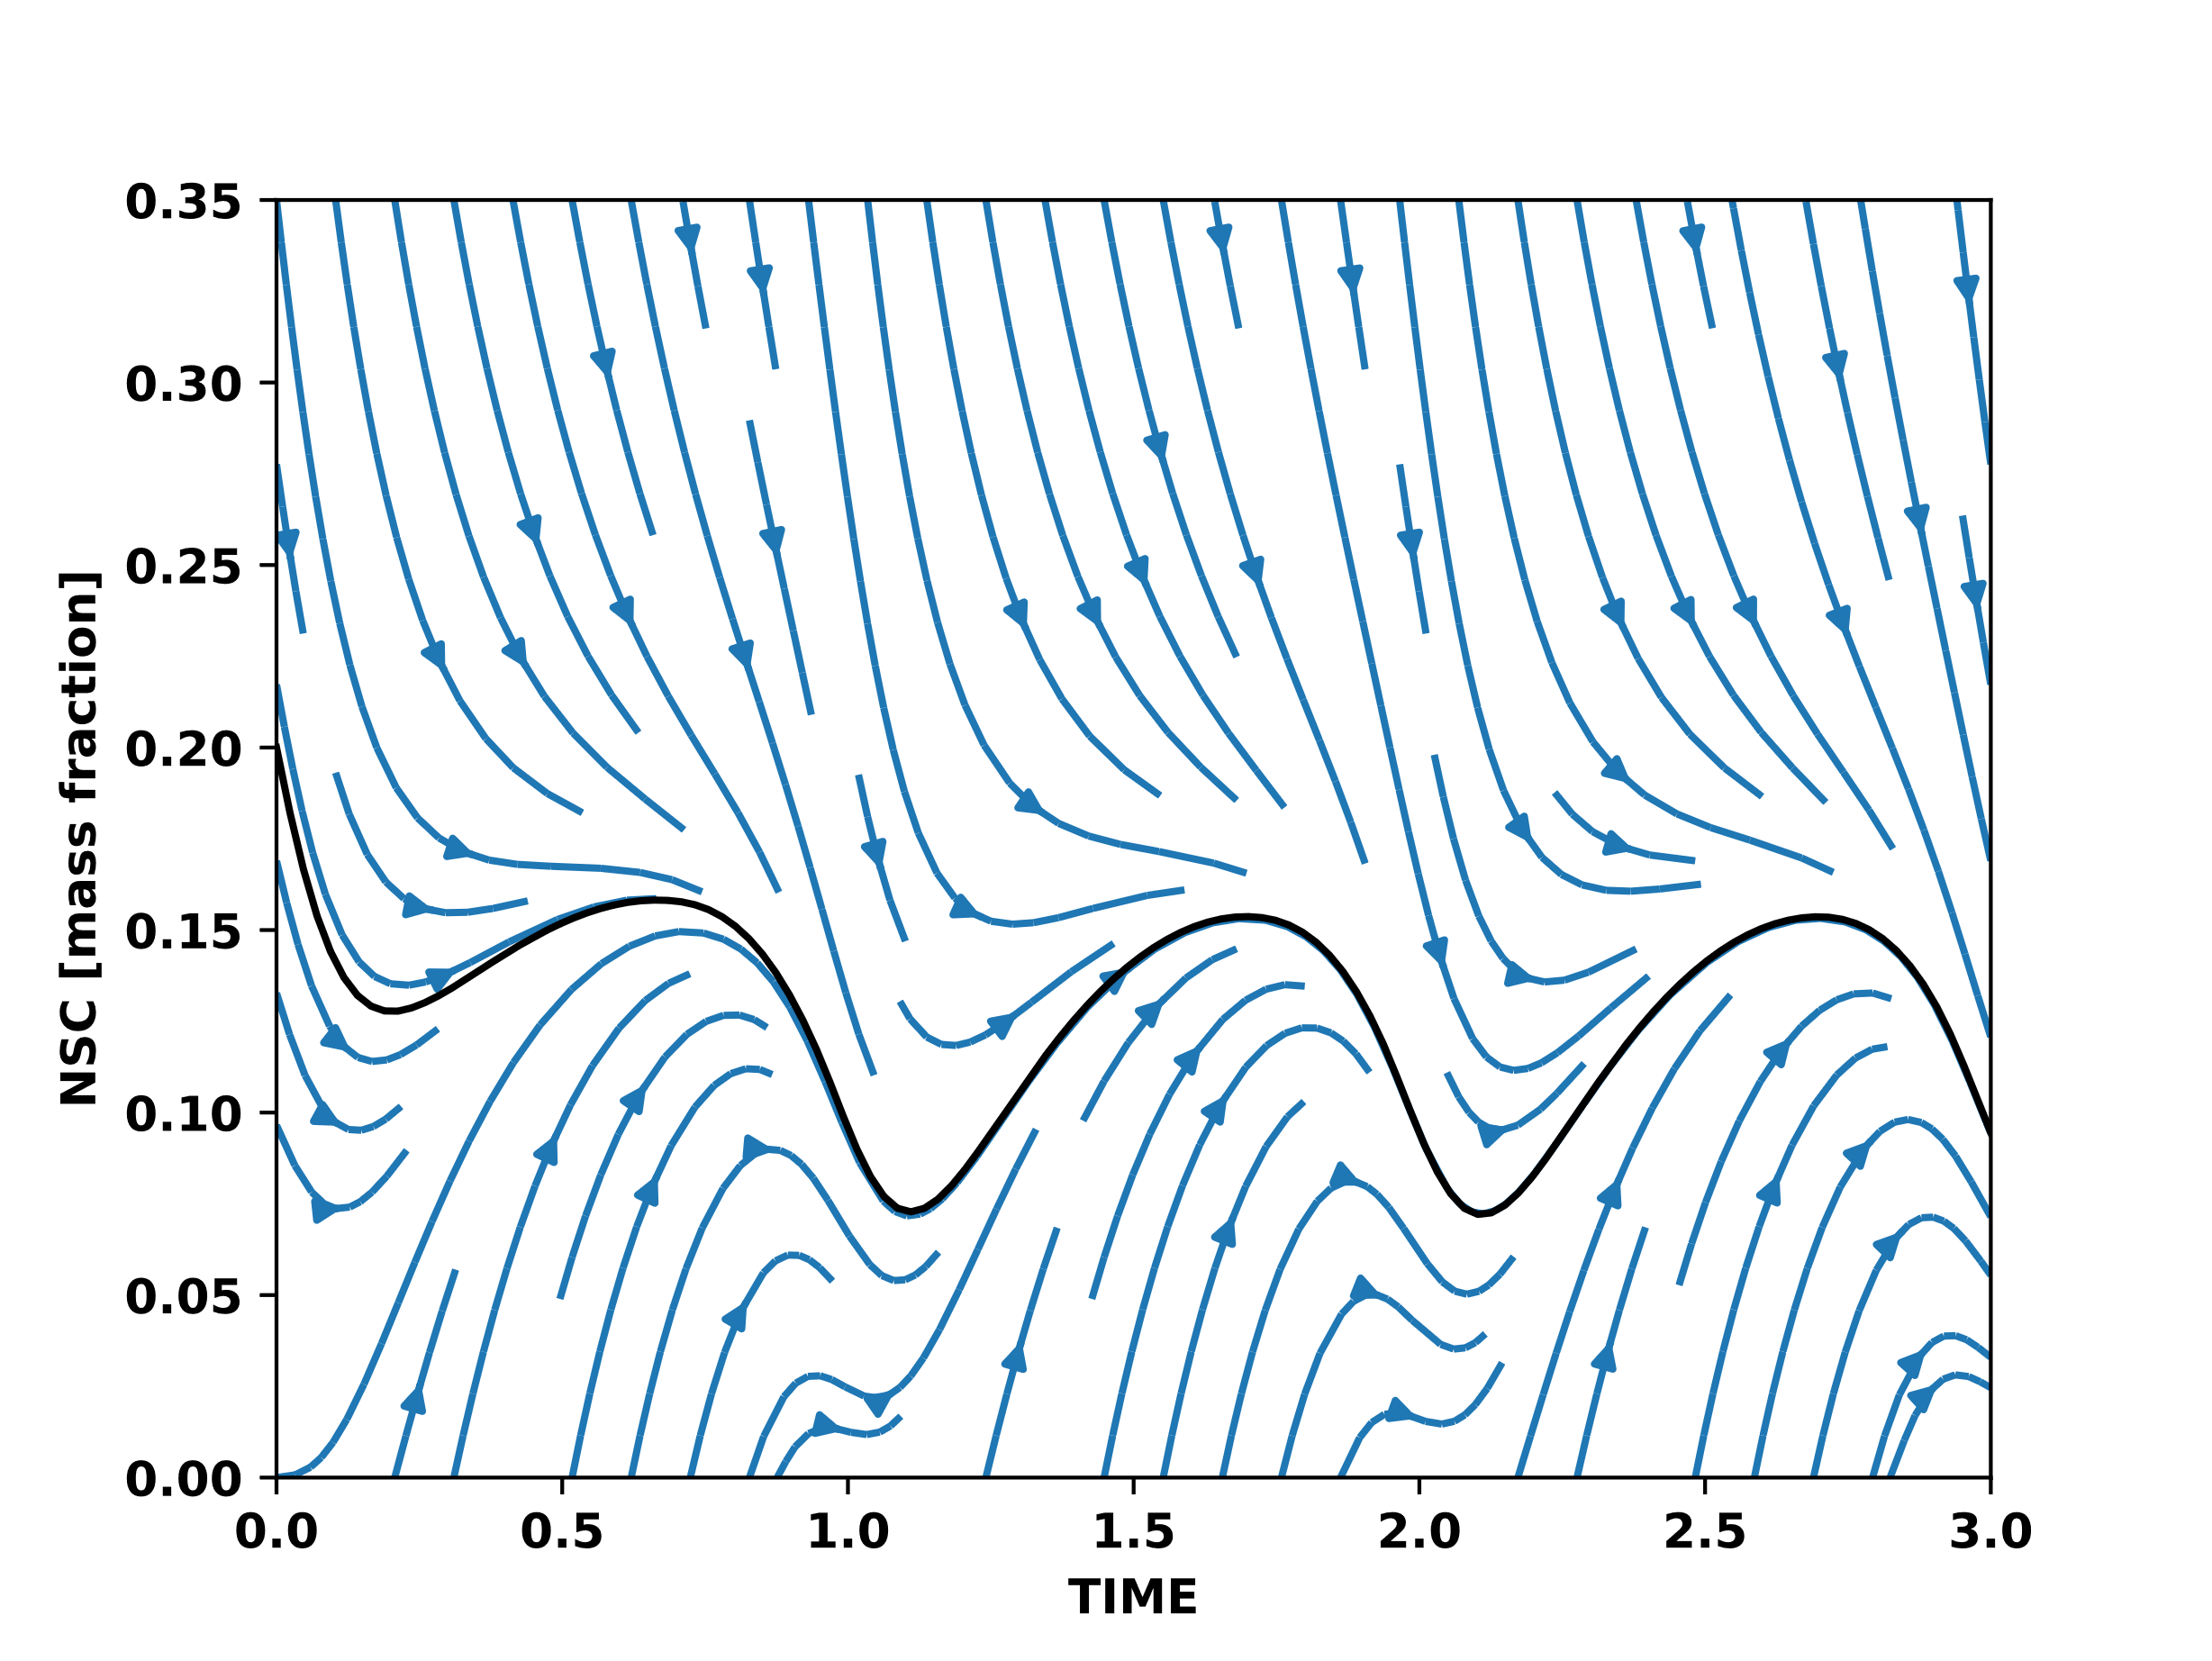
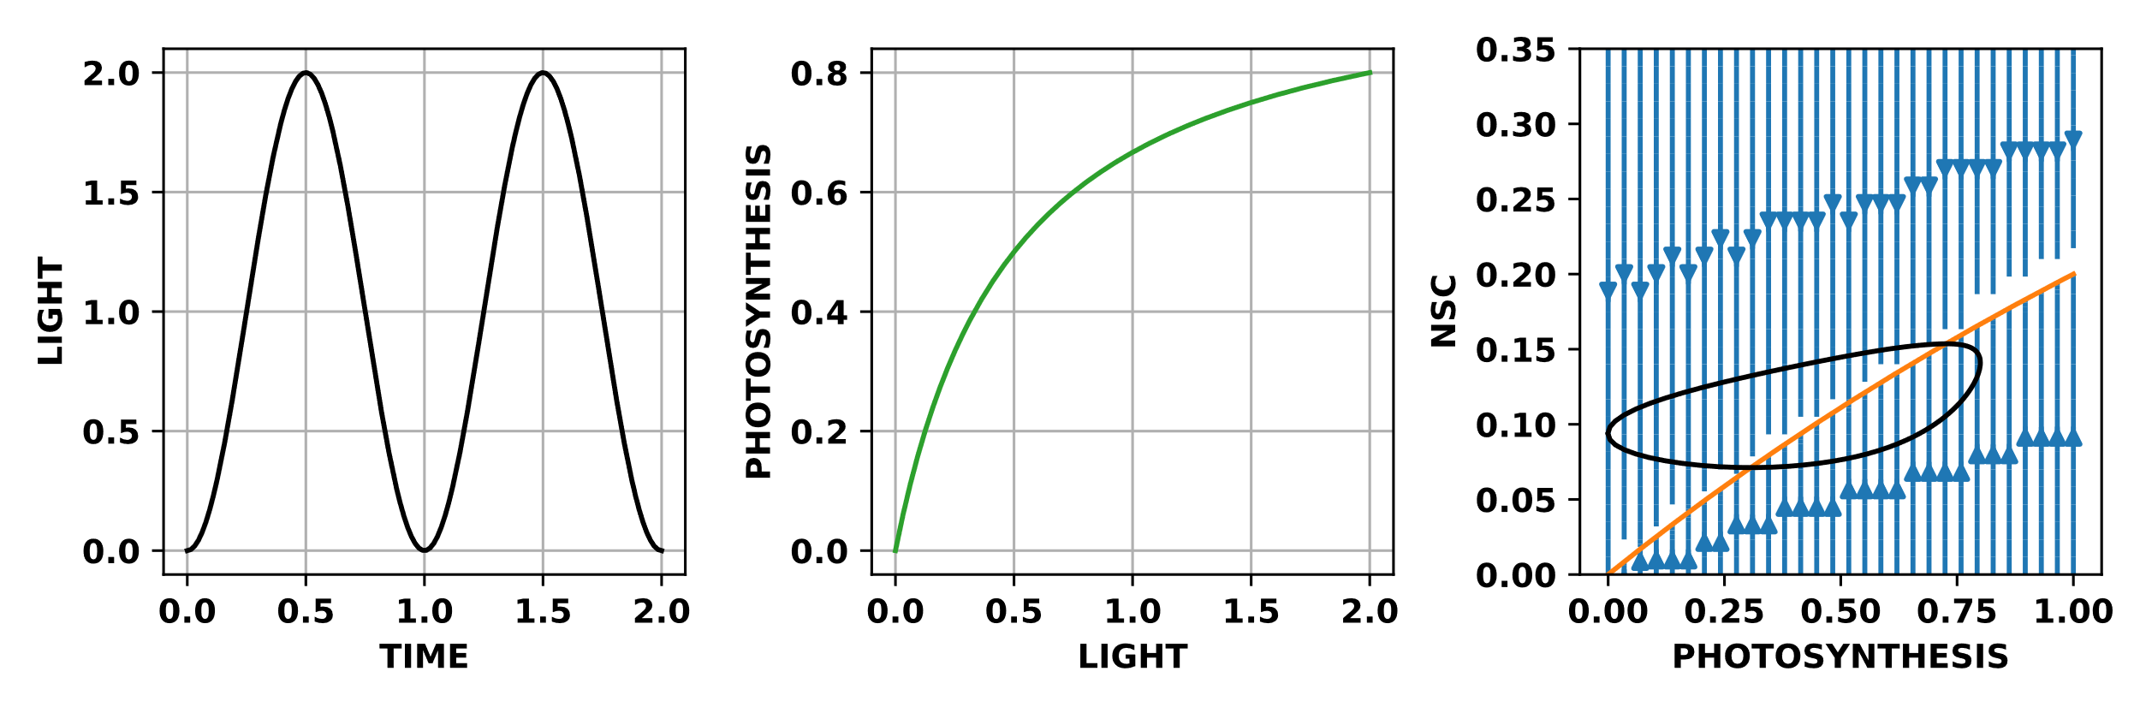

Slide 21
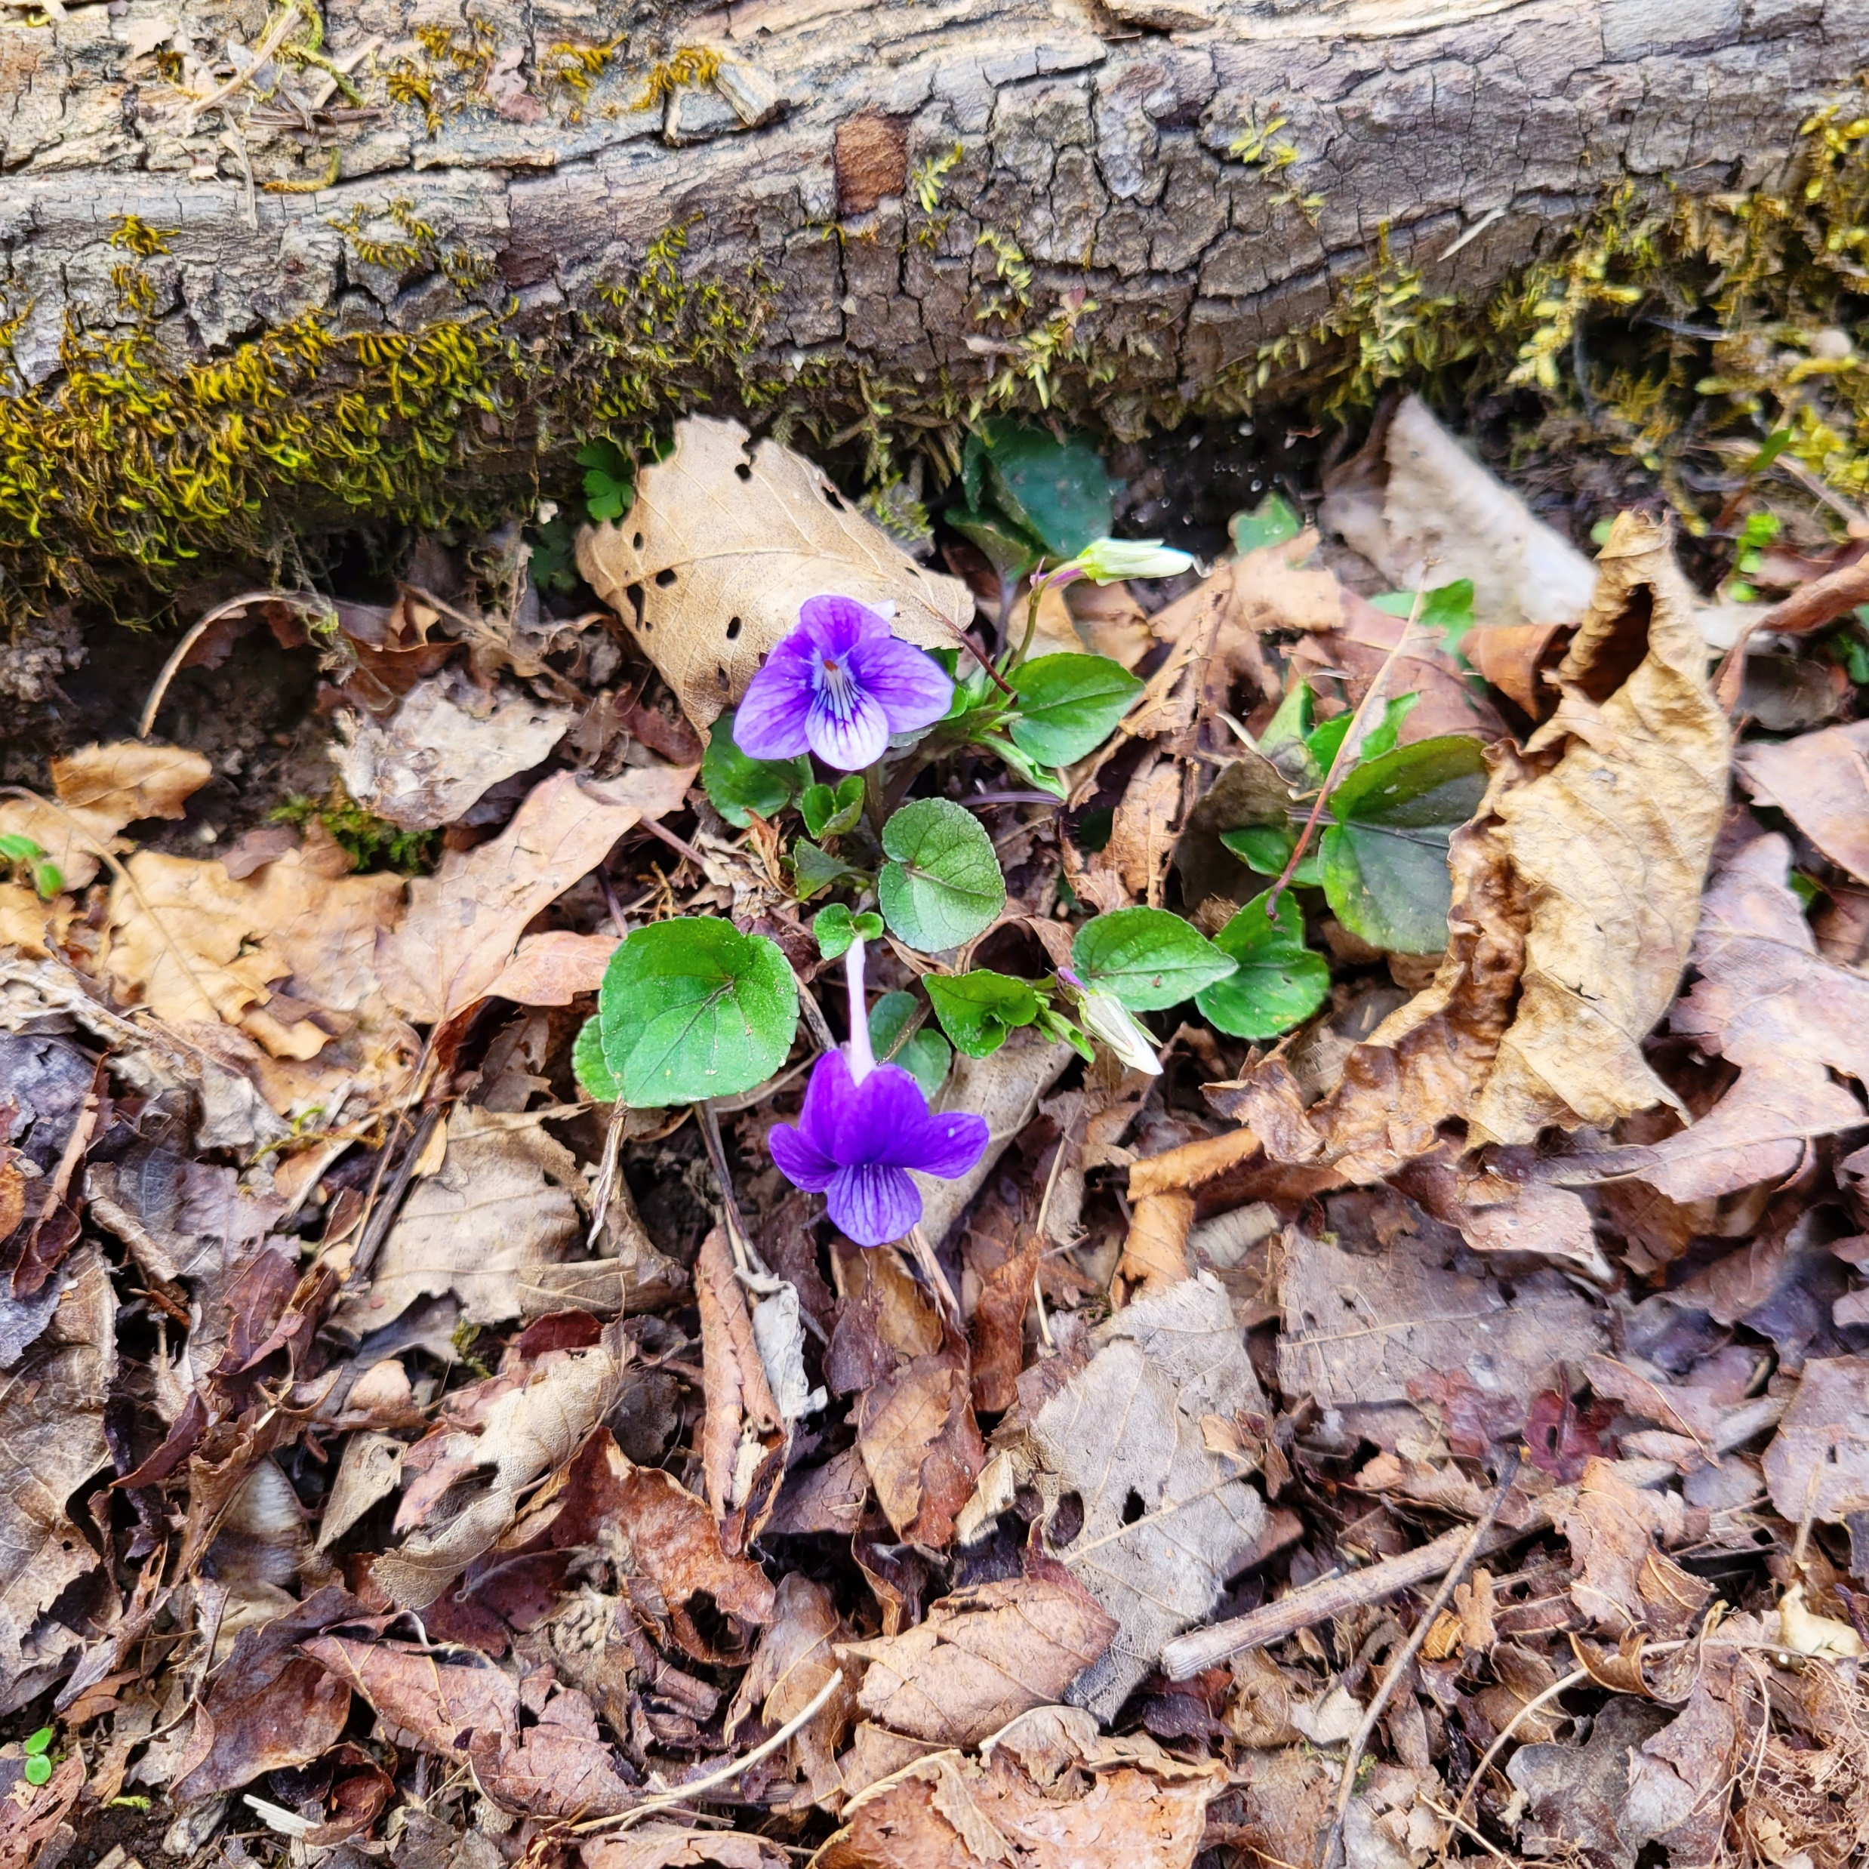
Stability → Attractor
Attractor → NSC feedback

Slide 23
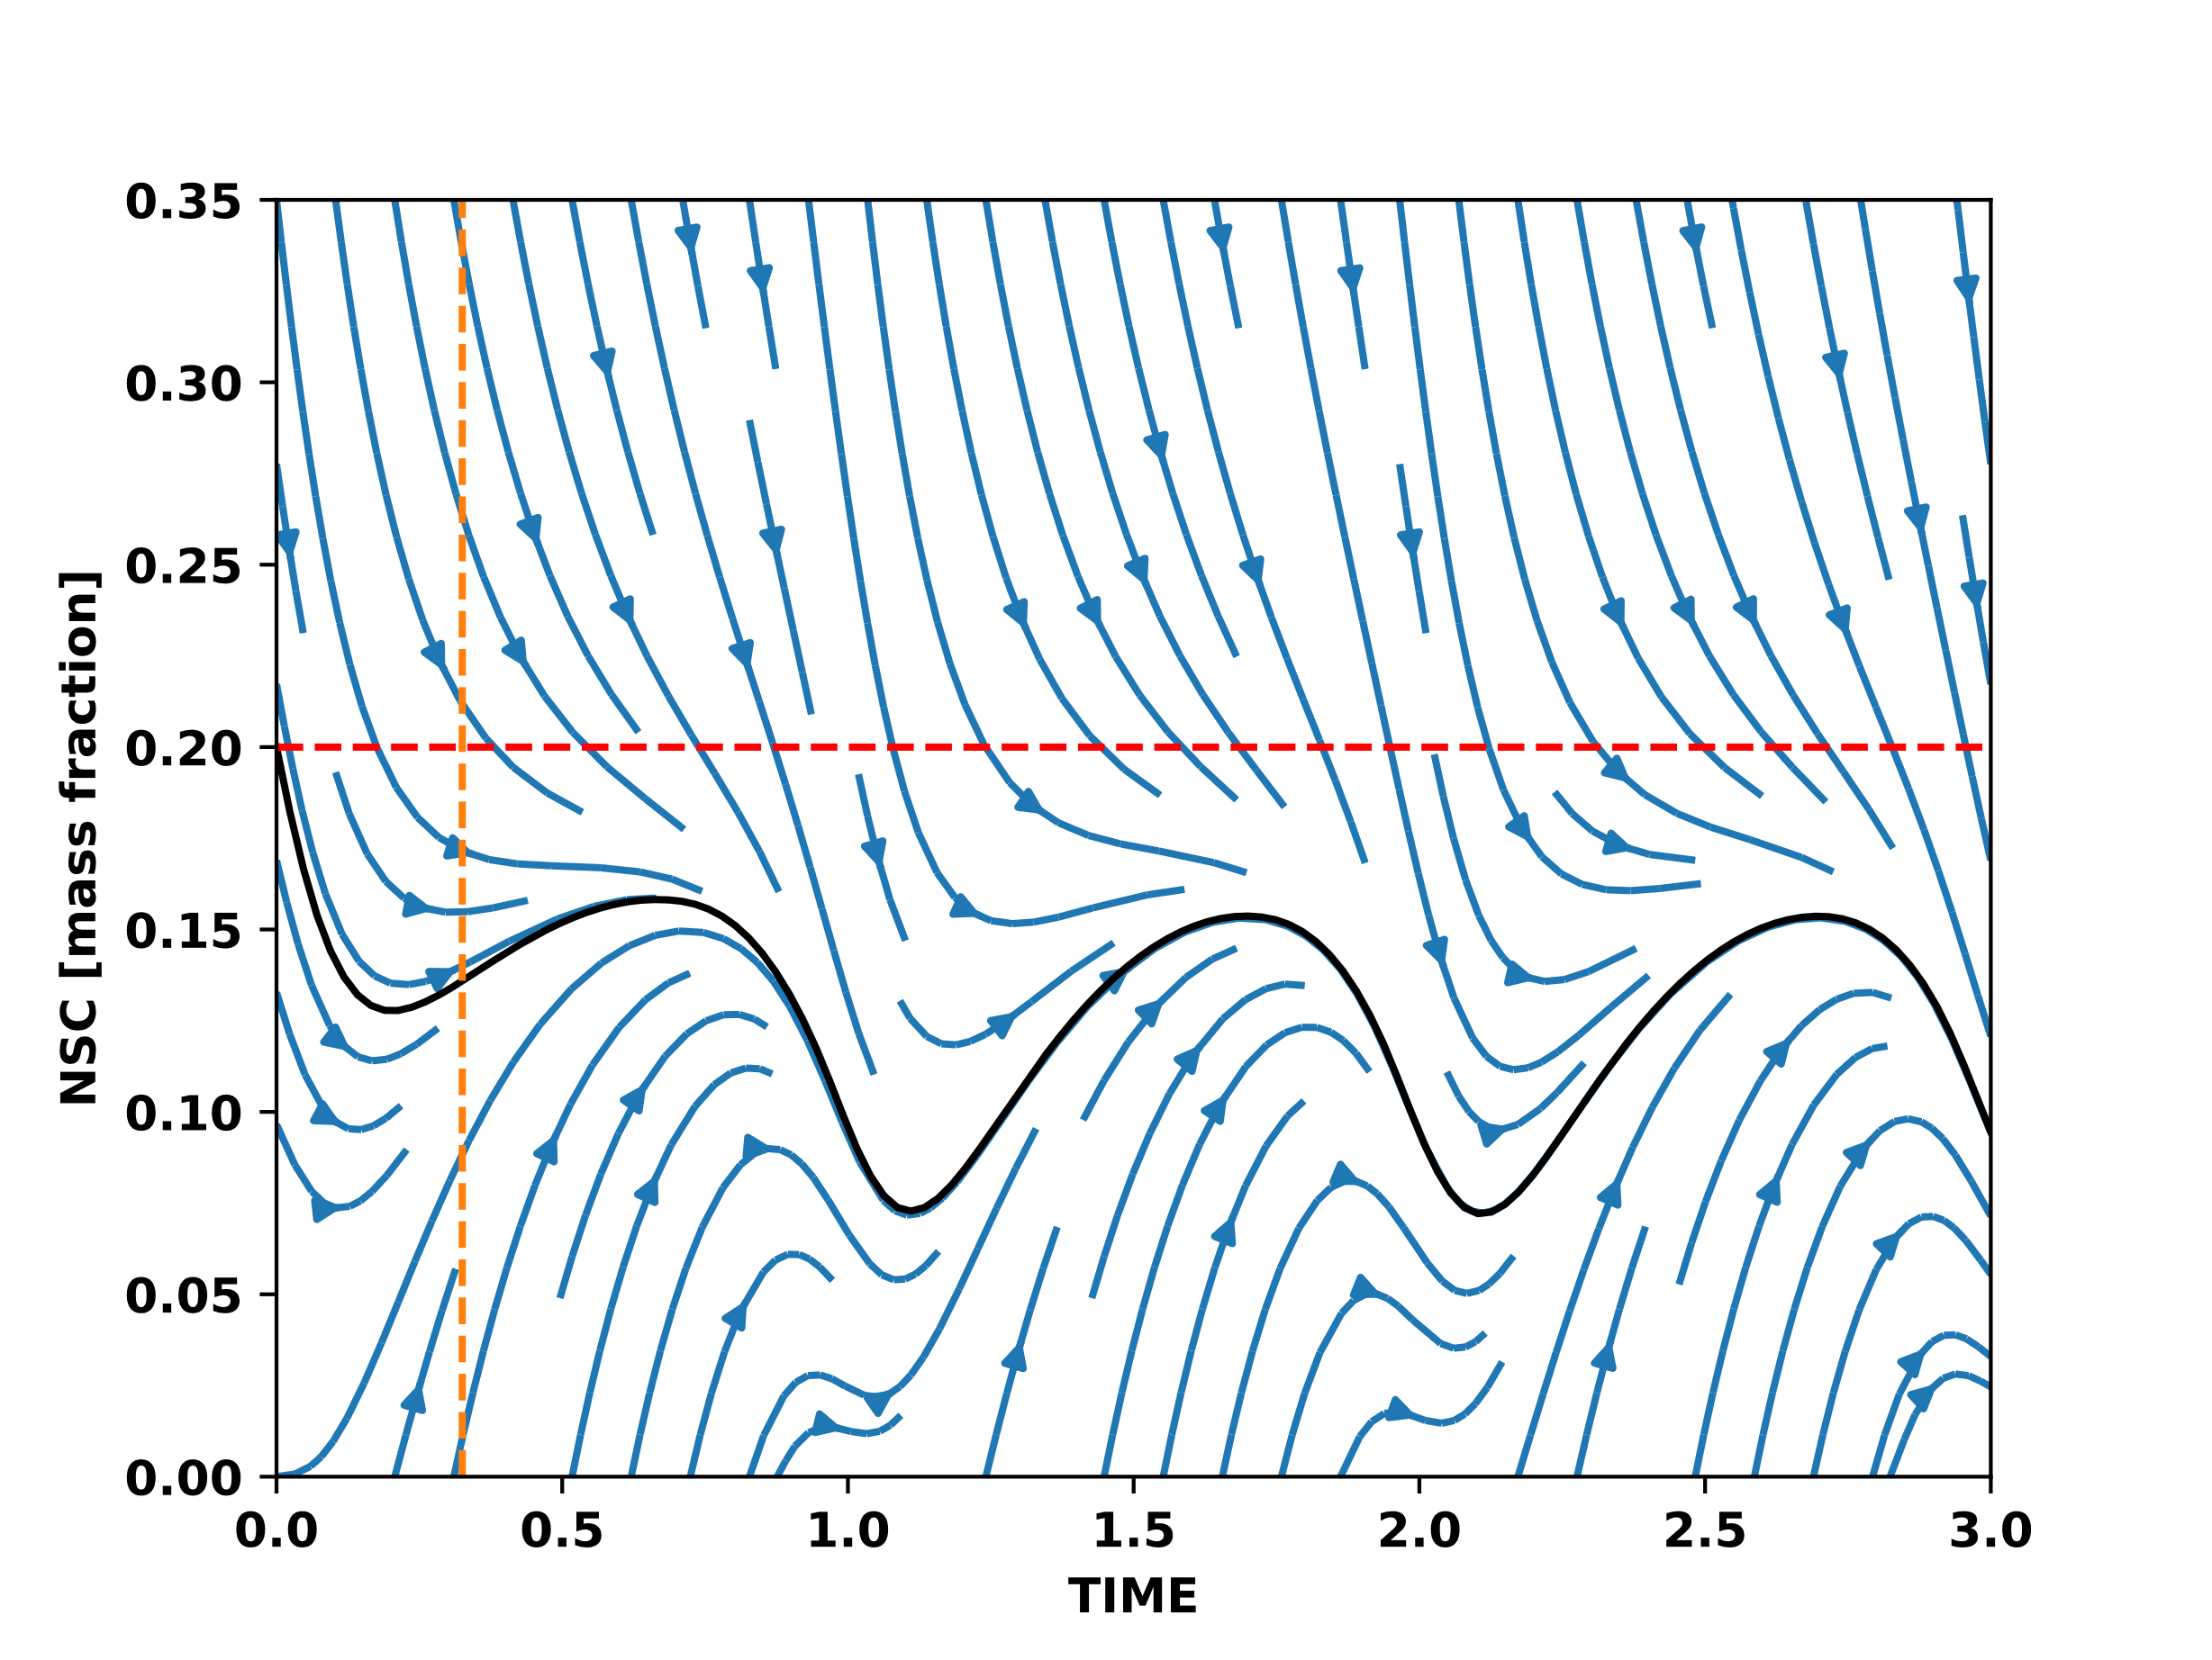
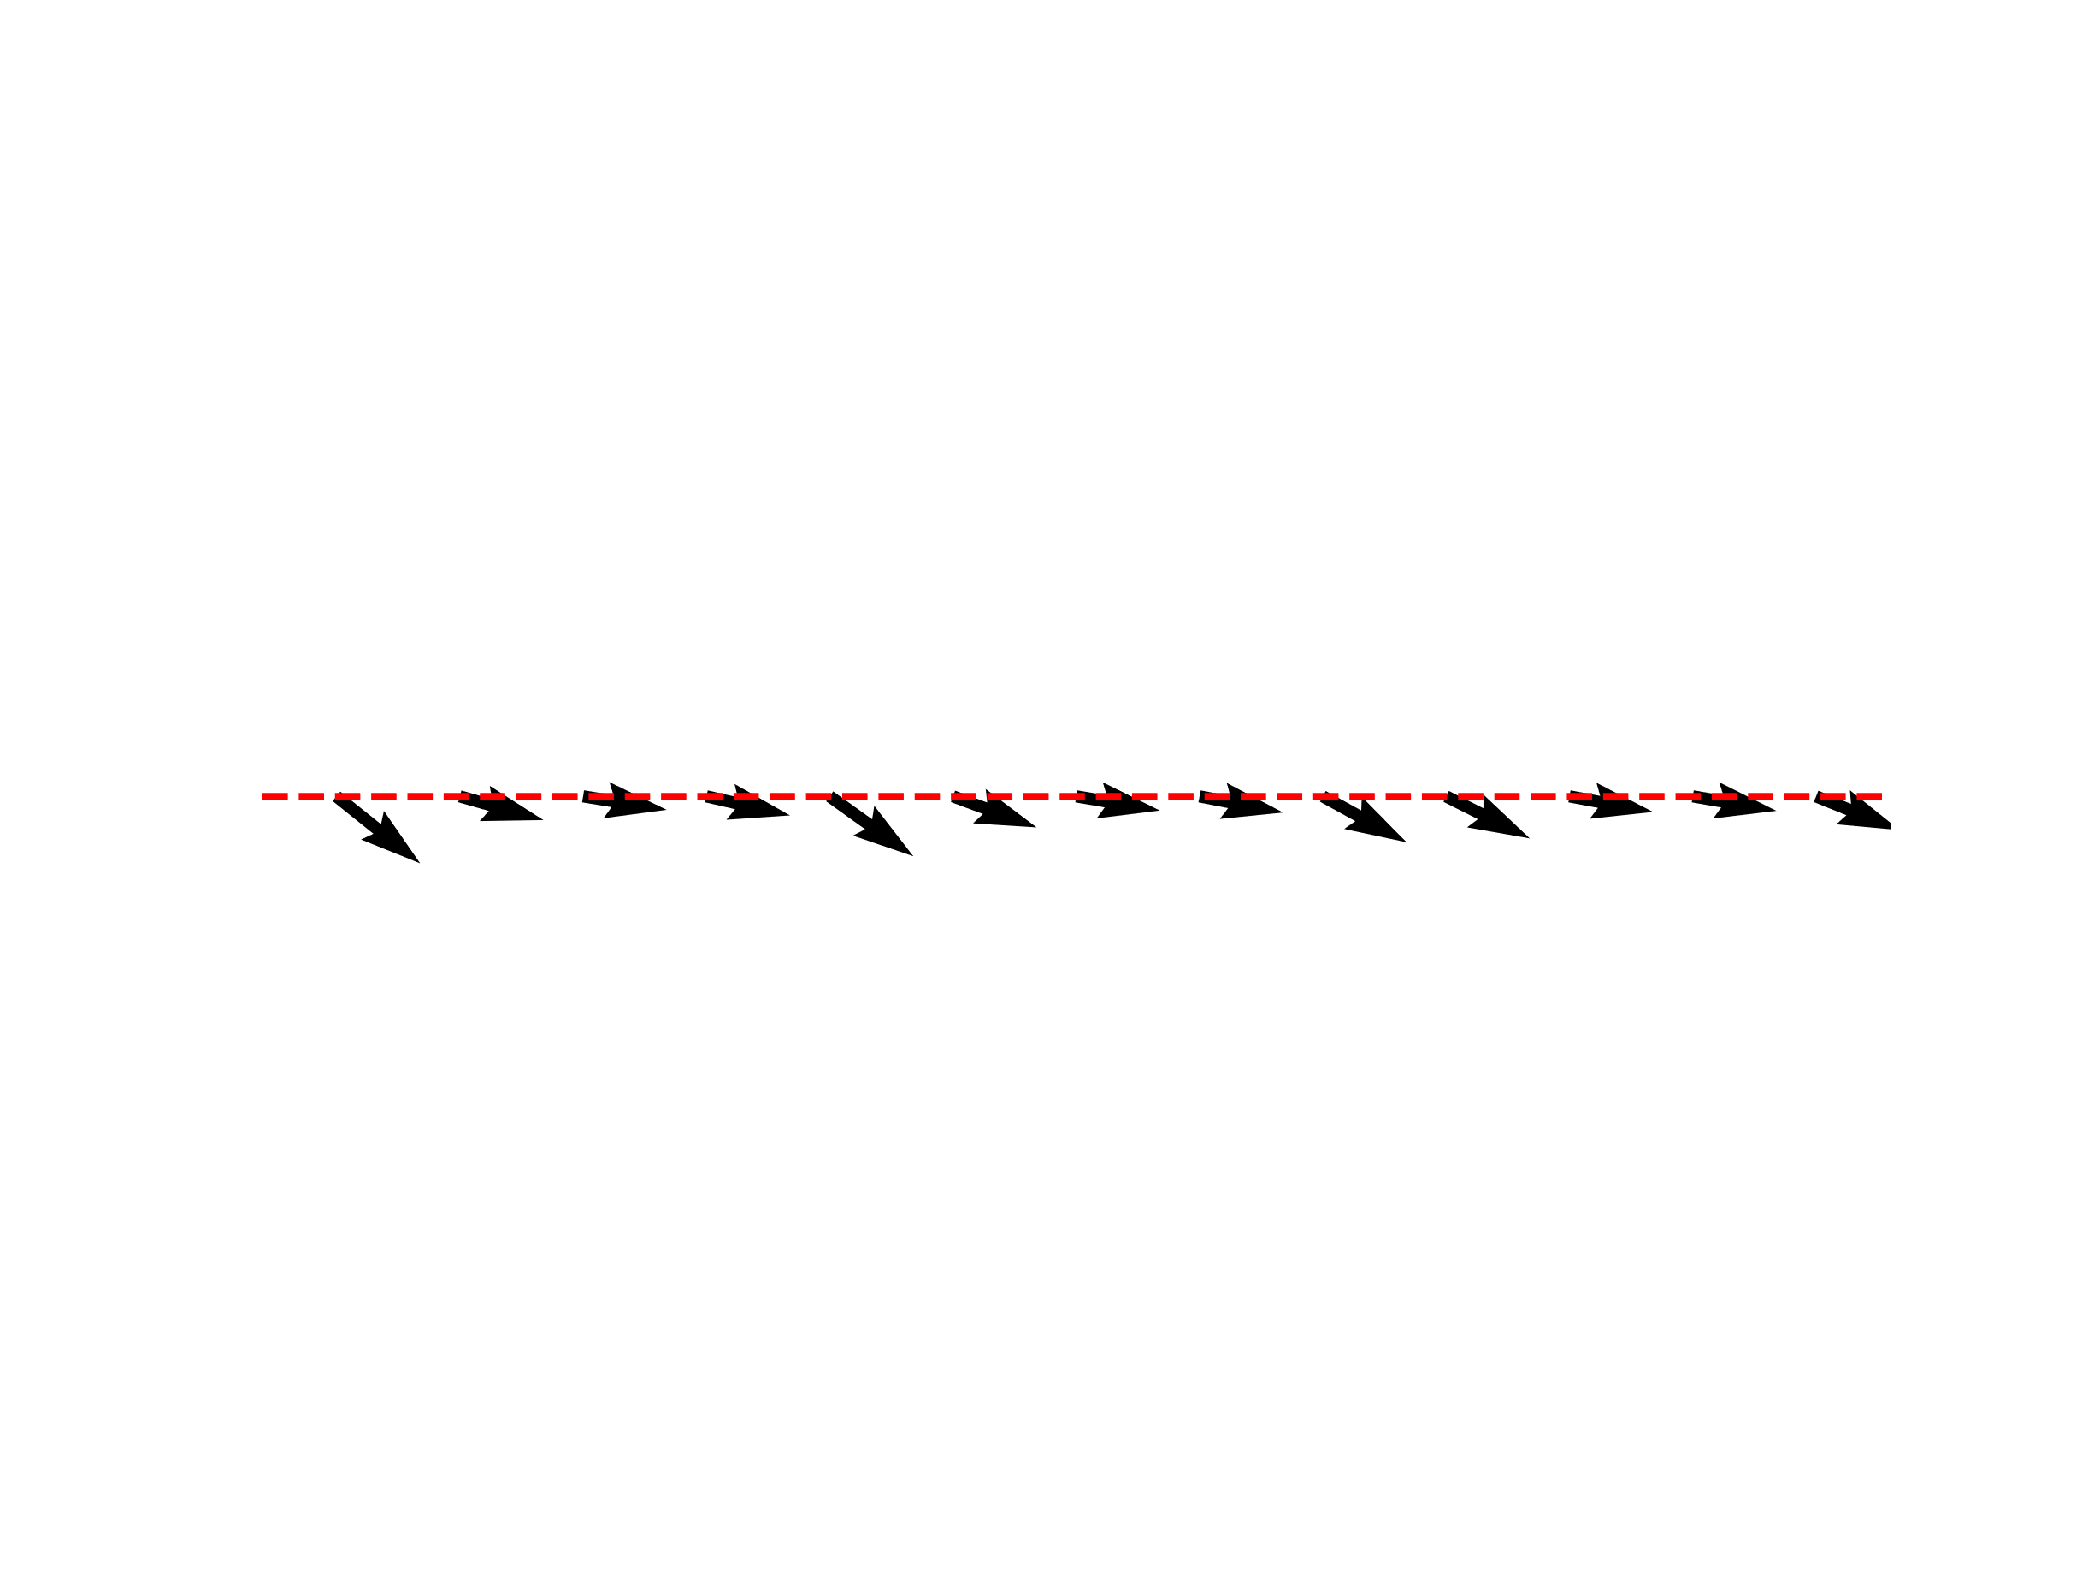
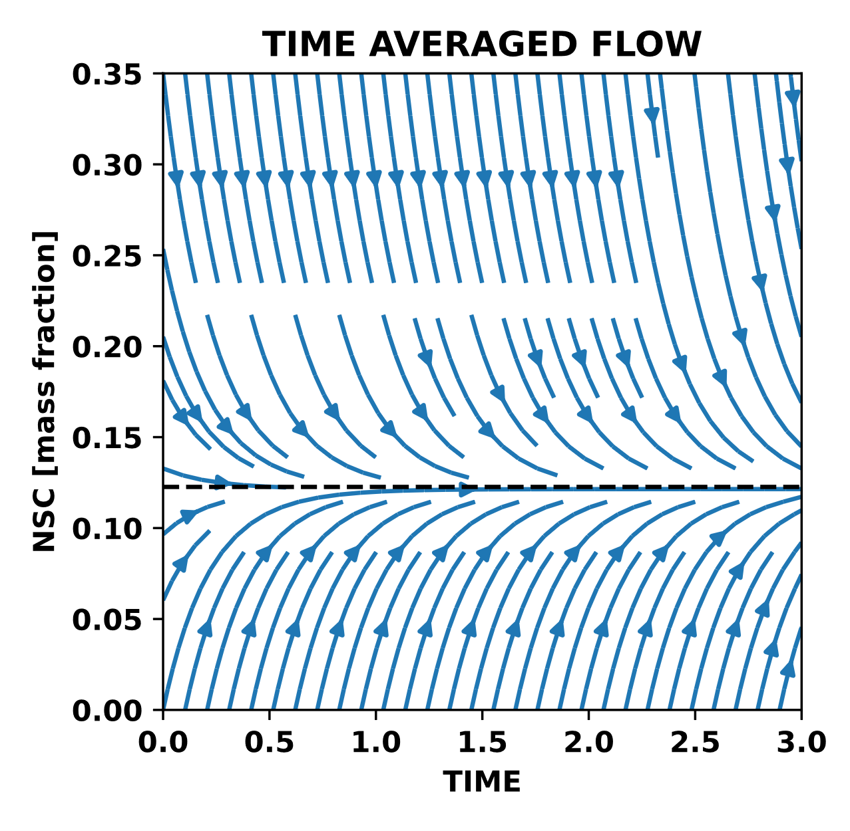

Slide 24
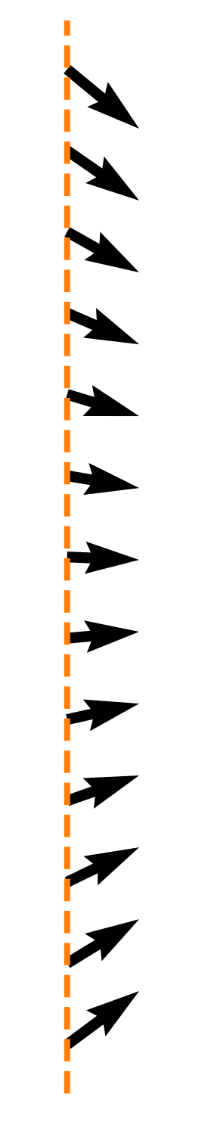

Slide 25
